Slide 1
Radioactive Waste
Why Are There No Permanent High-Level Radioactive Waste (HLW) Storage Sites in the United States?
A Short Discussion
Presented by
John Smith, Ph.D. Candidate
University of Colorado, Colorado Springs

Slide 2
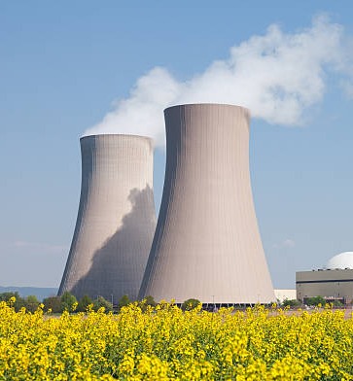
What is High-Level
Radioactive Waste?
High-Level Radioactive Waste (HLW) is the dangerous biproduct of
decommissioned nuclear sites, nuclear weapons, and spent nuclear
power-plant fuel rods. A Spent fuel rod is dangerous to people in the
vicinity because it “is highly radioactive….ten years after removal….[it
is still] expected to cause immediate incapacitation and death…” [1]
According to the U.S. Nuclear Regulatory Commission, storing this
waste is extremely hazardous and problematic since “…plutonium-239
has a half-life of 24,000 years, and plutonium-240 has a half-life of
6,800 years.” [1]

Slide 3
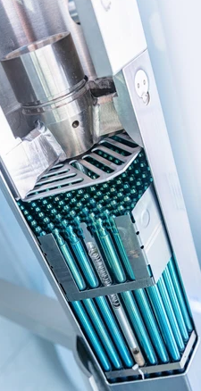
Why Not Just Store It
Somewhere Safe?
Storage is a problem because of the unknown longevity of the storage
barrels, and the fact that “used nuclear fuel rods require periodic
replacement which, unlike wind and solar energy, requires safe
storage because they are still hot and radioactive.” [2]
This creates an overwhelming amount of radioactive waste since rods
must be replaced and stored as safely as possible every year.
The EPA states that in the U.S. “there is currently no permanent
disposal facility for high-level waste. HLW must continue to be stored
at commercial reactors and selected DOE facilities.” [3]
Fig. 1. Nuclear fuel rods.

Slide 4

No HLW Storage -
New Answers Needed
Storing HLW onsite is extremely dangerous. With varying half-lives of
6,000 to 200,000 years, who will regulate a facility and guarantee the
facility is maintained for thousands of years? We have no country on
our planet which has survived that long.
For now, there are no permanent HLW disposal sites because the
United States is waiting for an answer. Germany could not find a safe
answer, so they shut down all of their nuclear power plants
in 2023.

Slide 5
References
[1] United States Nuclear Regulatory Commission, “Radioactive waste: production, storage, disposal,” pp. 7-8, May 2020.
[2] F. Rowold, k. Hummelsheim, S. Kersen, J. Stewering, “Radiological aspects and behavior of spent fuel considering long-term storage,” Progress in Nuclear Energy., vol. 84, pp. 1-5, Sept. 2020.
[3]United States Environmental Protection Agency, “High level radioactive waste,” pp. 1, Oct. 2024.

